Slide 1
Impact of Poverty & Racism on the Economy of the Region
Presented by
Jerome H. Underwood
Wade Norwood
John Strazzabosco
12.21.21

Slide 3
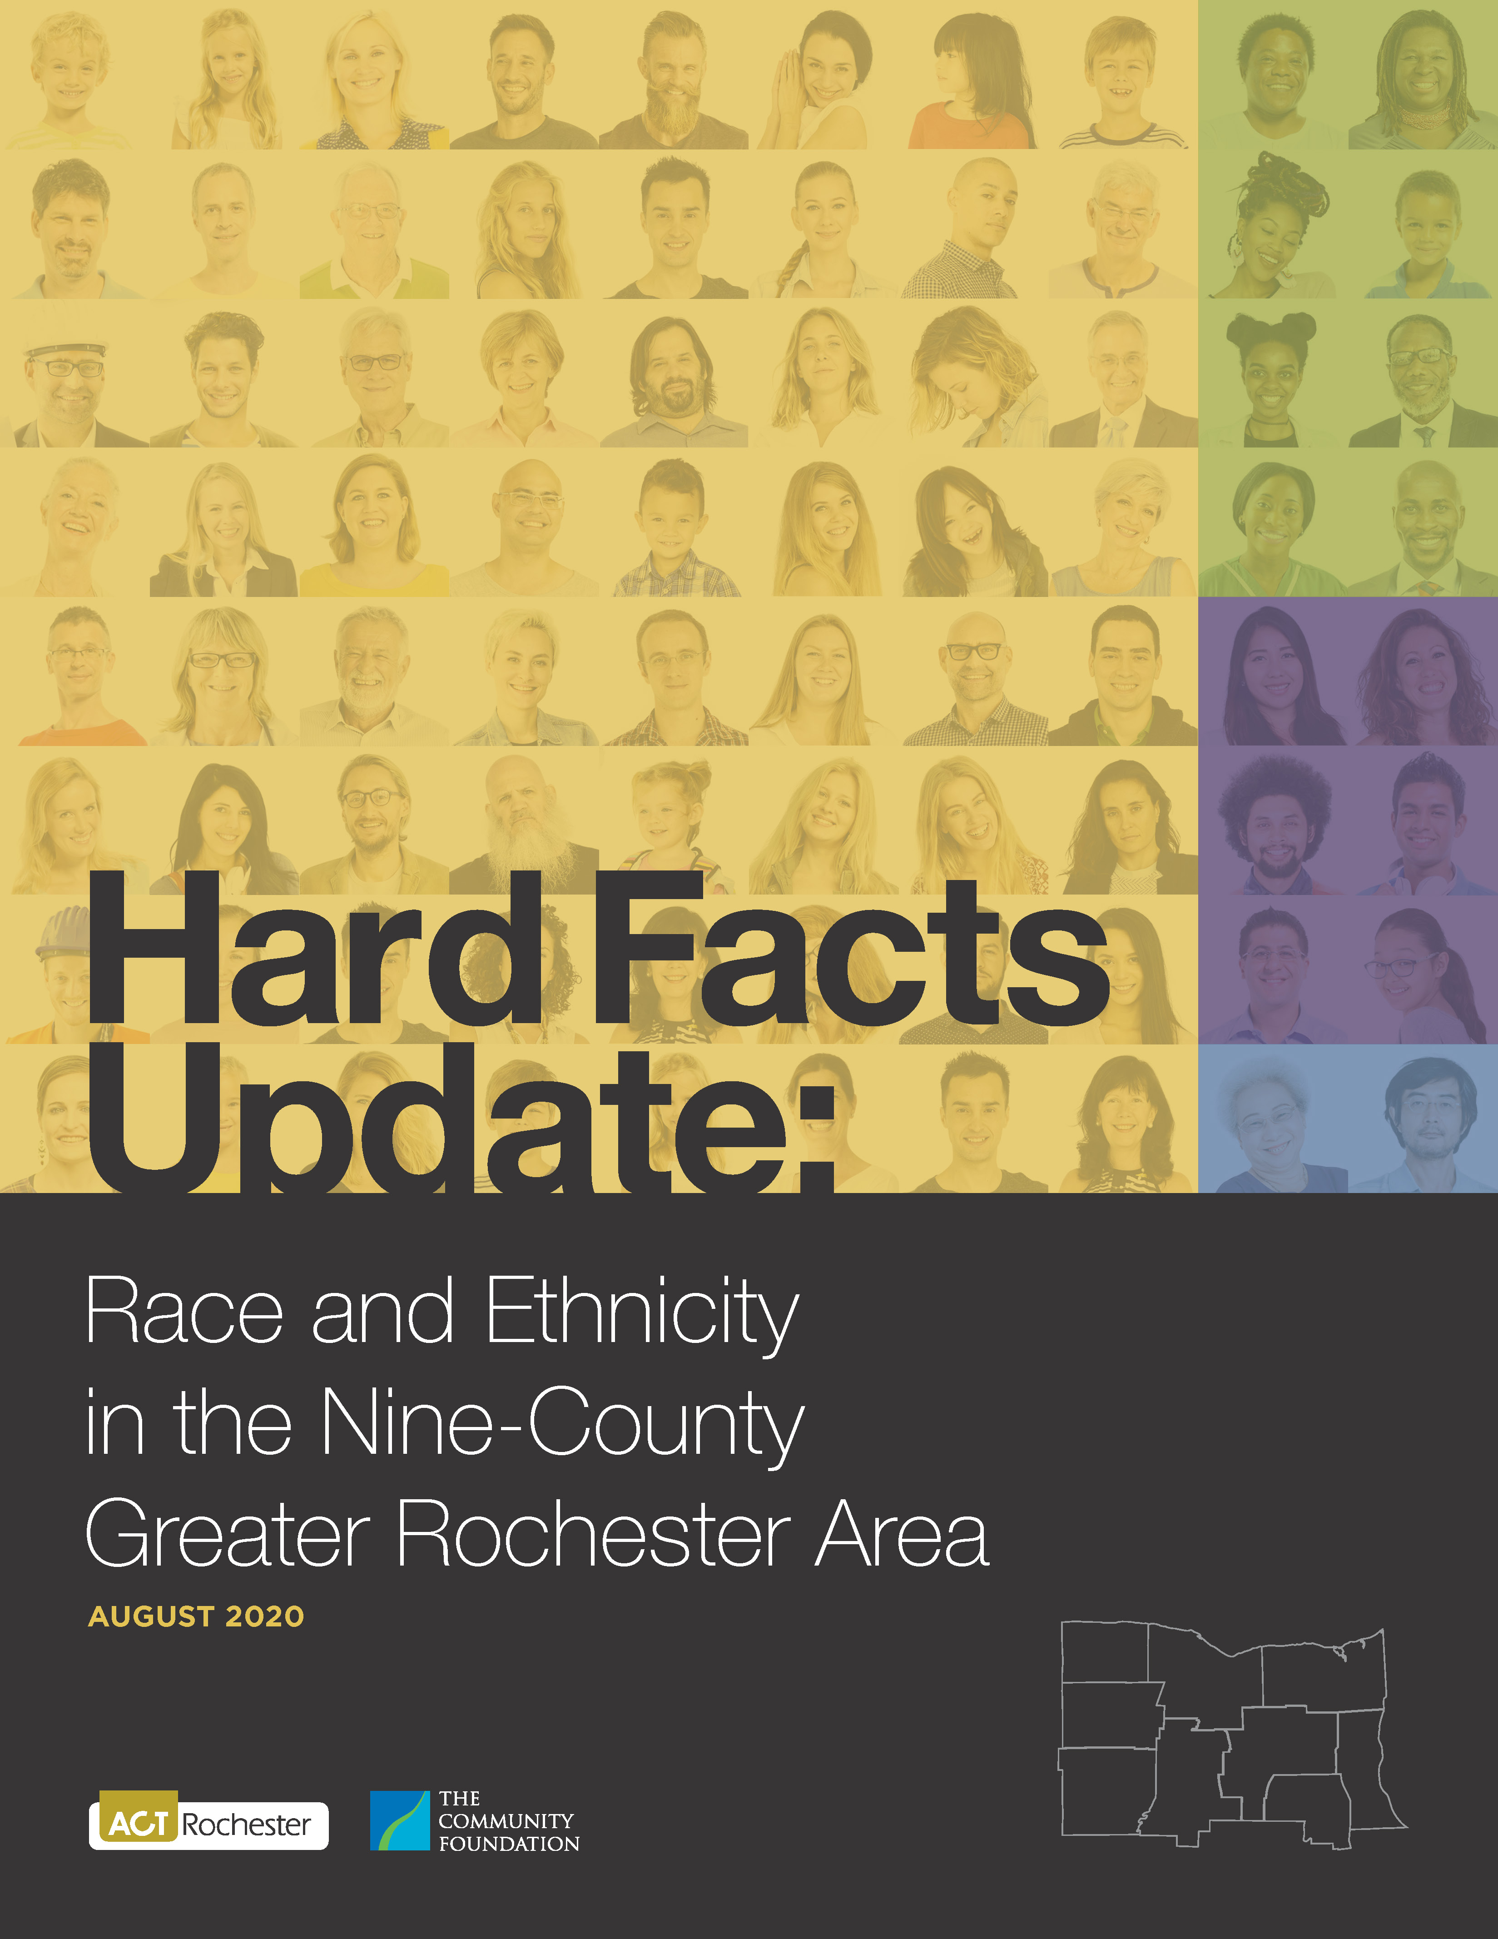
Racism is a Public Health Crisis
The nine-County region includes: Monroe, Wayne, Ontario, Seneca, Yates, Livingston, Wyoming, Genesee, and Orleans

Slide 4
Racism is a Public Health Crisis Hard Facts 2020
Why this report?
To create a deeper knowledge of the inequalities faced by people of color in the nine-county Rochester region
To stimulate conversations leading to fuller understanding and community action
A Process for Community Change:
Knowledge
Understanding
Action

Slide 5
Hard Facts 2020
Why the emphasis on African Americans and Latinos?
The nine-county regional population is more than 82% White.
The 128,400 African Americans in the region account for 10.8% of the population, and are, by far, the largest POC group.
The region’s 81,600 Latina/Latino residents account for 6.8% of the total population.
The disparities experienced by these two groups are very similar and are dramatic.
Notes:
The region has become more diverse in the last 20 years. Hispanics up 67%; Asians up 52%; AA up 13%; Whites down 2%

Slide 6
Hard Facts 2020
Key Findings:
Disparities impact individuals and families throughout their lives, and even into future generations. Wide gaps exist in all measures.
The gaps between racial and ethnic groups are greater in the Rochester region than in the United States or New York State as a whole.
These results have a demonstrable impact on the well-being of the Rochester region.

Slide 7
Hard Facts 2020
“The opposite of poverty isn’t wealth. The opposite of poverty is justice.”
Bryan Stevenson

Slide 8
Hard Facts 2020
VICIOUS CYCLE:
Infant mortality/morbidity
Unemployment/Under Employment
Education
Health disparities are pervasive and persist for generations.
How did it get this way? Systematically!

Slide 9
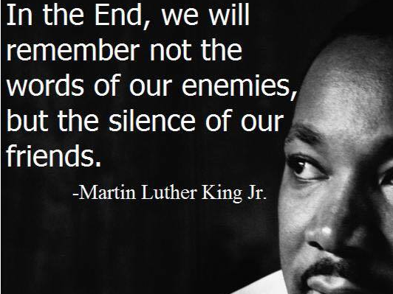

Slide 10
The Color of Health
The Devastating Toll of Racism on Black Lives

Slide 11
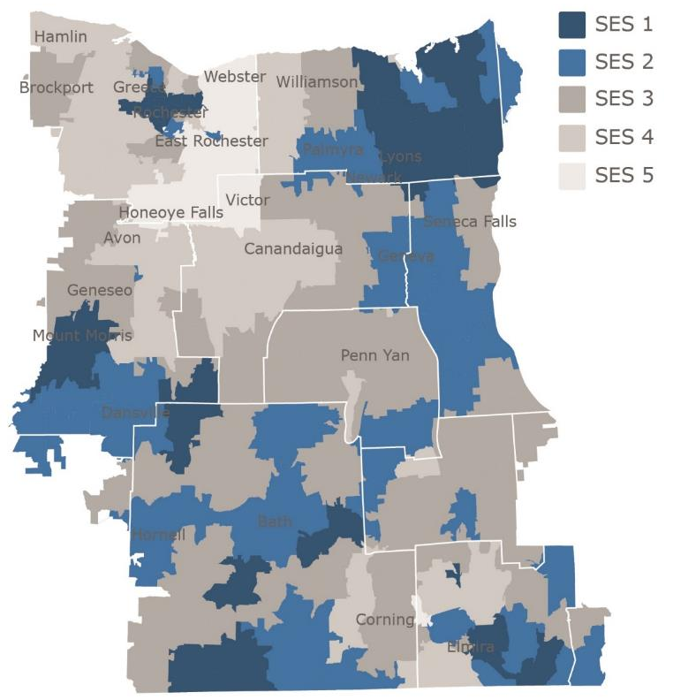
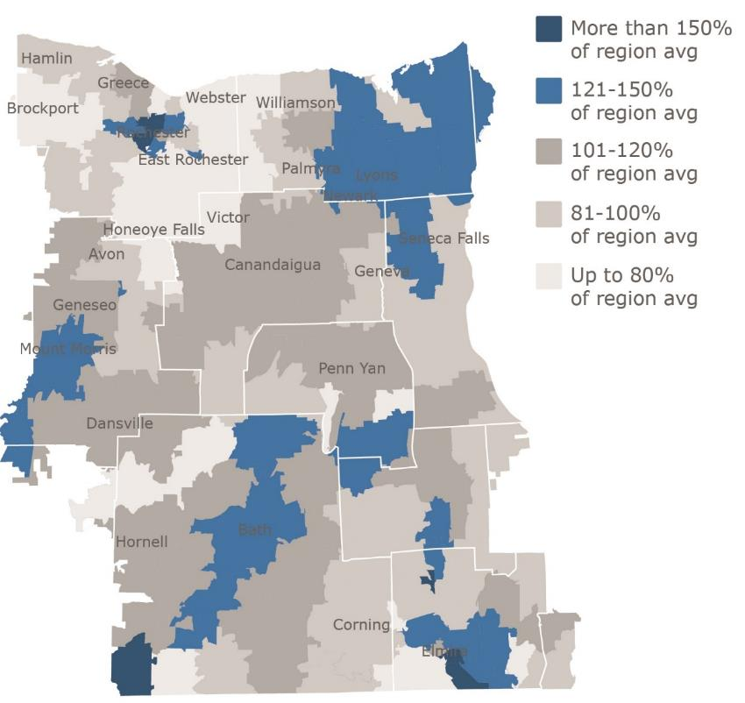
Poverty cuts lives short across the region
Low socioeconomic status in blue
High Years of Potential Life Lost in blue
Source: American Community Survey (left); New York State Department of Health Vital Stats
Notes:
Map shows ZIP codes with lowest socioeconomic status
Each ZIP rated 1-5 based on an index we created of 12 different indicators including poverty rate, unemployment, average income, home ownership and value
Lowest SES areas marked in blue – mix of urban and rural.
Second map based on premature mortality rates – the blue areas have the highest rates of years of potential life lost
Same areas with low SES tend to have highest rates of premature mortality.
Notes:
The Socioeconomic Status (SES) index ranking was developed by Common Ground Health and calculated using a variety of socioeconomic indicators from the American Community Survey including average income, poverty rates, education levels, housing value, and homeownership. Each ZIP code is assigned an SES index ranking from 1 to 5. The lower SES ZIP codes tend to have lower average income, higher poverty rates, lower prevalence of college degrees, etc.
Years of Potential Life Lost (YPLL) is a widely used measure to assess the rate of premature mortality. YPLL places a larger weight on the deaths of younger people, in contrast with overall mortality statistics which are dominated by deaths of the elderly. The YPLL rates in Common Ground Health’s analyses are derived using 75 years of age as the baseline. Therefore, a death at age 65 has a YPLL of 10, whereas a death at age 35 has a YPLL of 40. Rates are calculated per 100,000 population, and are age- and sex-adjusted to account for differences in population distribution.

Slide 12
African Americans in our region are:
Nearly
6 times
as likely to wind up in Emergency Room due to asthma
More than
3 times
as likely to have infant die within a year of birth
Nearly
6 times
as likely to be admitted to the hospital due to hypertension
Nearly
4 times
as likely to be admitted to the hospital due to diabetes
Notes:
Mortality statistics understate the impact of health inequity.
Many more lives are affected by higher rates of illness and less access to quality care.

Slide 13
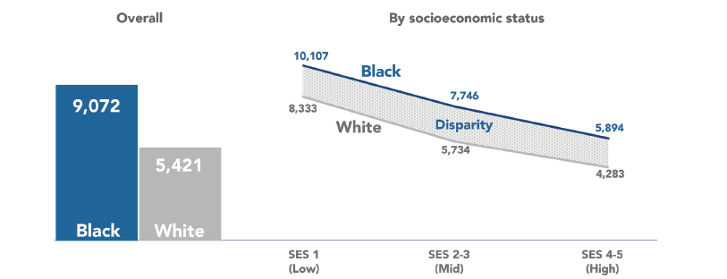
Black people die younger across all socio-economic levels
Years of potential life lost rate
Overall
By socioeconomic status
67% higher
Black
White
All rates are age/sex adjusted and shown per 100,000 residents
SOURCE: NYSDOH Vital Statistics for Finger Lakes nine county region 2015-2017; Analysis by Common Ground Health
Source: NYSDOH Vital Statistics for Finger Lakes nine county region 2015-2017; Age-Sex Adjusted Analysis by Common Ground Health
Notes:
To improve health for Black residents, we need to address what happens in the classroom, on the way to school, on the job and in the home. Health equity strategy must focus beyond the four walls of the medical clinic.
The Color of Health does just that.
The report connects the dots between the higher premature mortality rate for African Americans in Rochester and the Finger Lakes and the upstream social constraints Black residents are forced to navigate.
Just how much higher that rate remains is captured in a measure called Years of Potential Life Lost. That’s what you are looking at in this chart.
This mortality metric places a larger weight on the deaths of younger people by estimating the additional years a person would have lived had they not died before the age of 75.*
This is a particularly meaningful measure as it captures the difference between my XXX dying at age XX in the prime of his life, and my XXX dying at age XXX, after a long and productive life.
As you see from the chart, Black residents regionally have a 67% higher rate of YPLL than their White counterparts.
But it’s the chart on the right that I really want you to look at and if you remember only one thing from this press conference, this is the point to take away.
How do we know that the disparity we are seeing for Blacks is not the outgrowth of poverty? After all, Common Ground has spent the past few years focusing community attention on the health costs of poverty.
Here, you see that at every social economic level, Black people are dying younger than White people. Yes poverty is problem, but there is clearly more to the story.
If you are Black, whether you live on the financial edge or enjoy a six figure salary, you are more likely to dies early. Racism cuts across class lines.

Slide 14
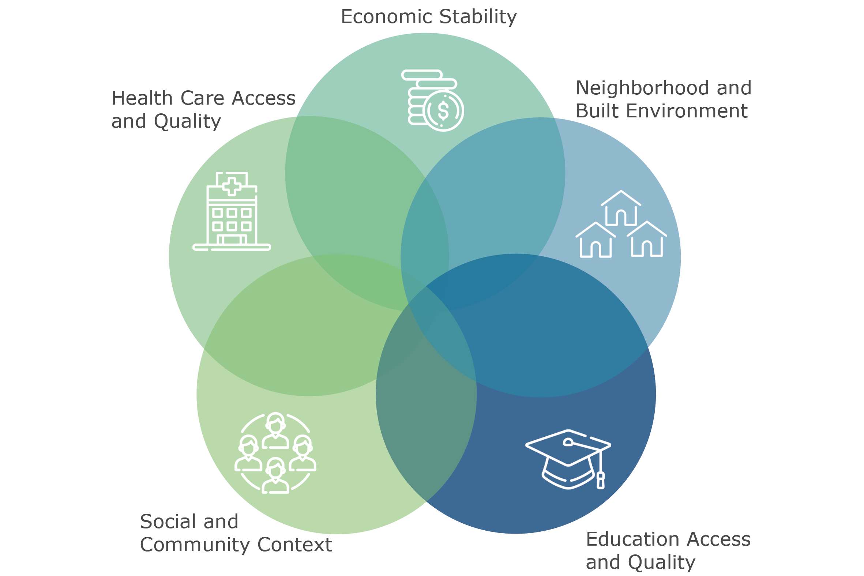
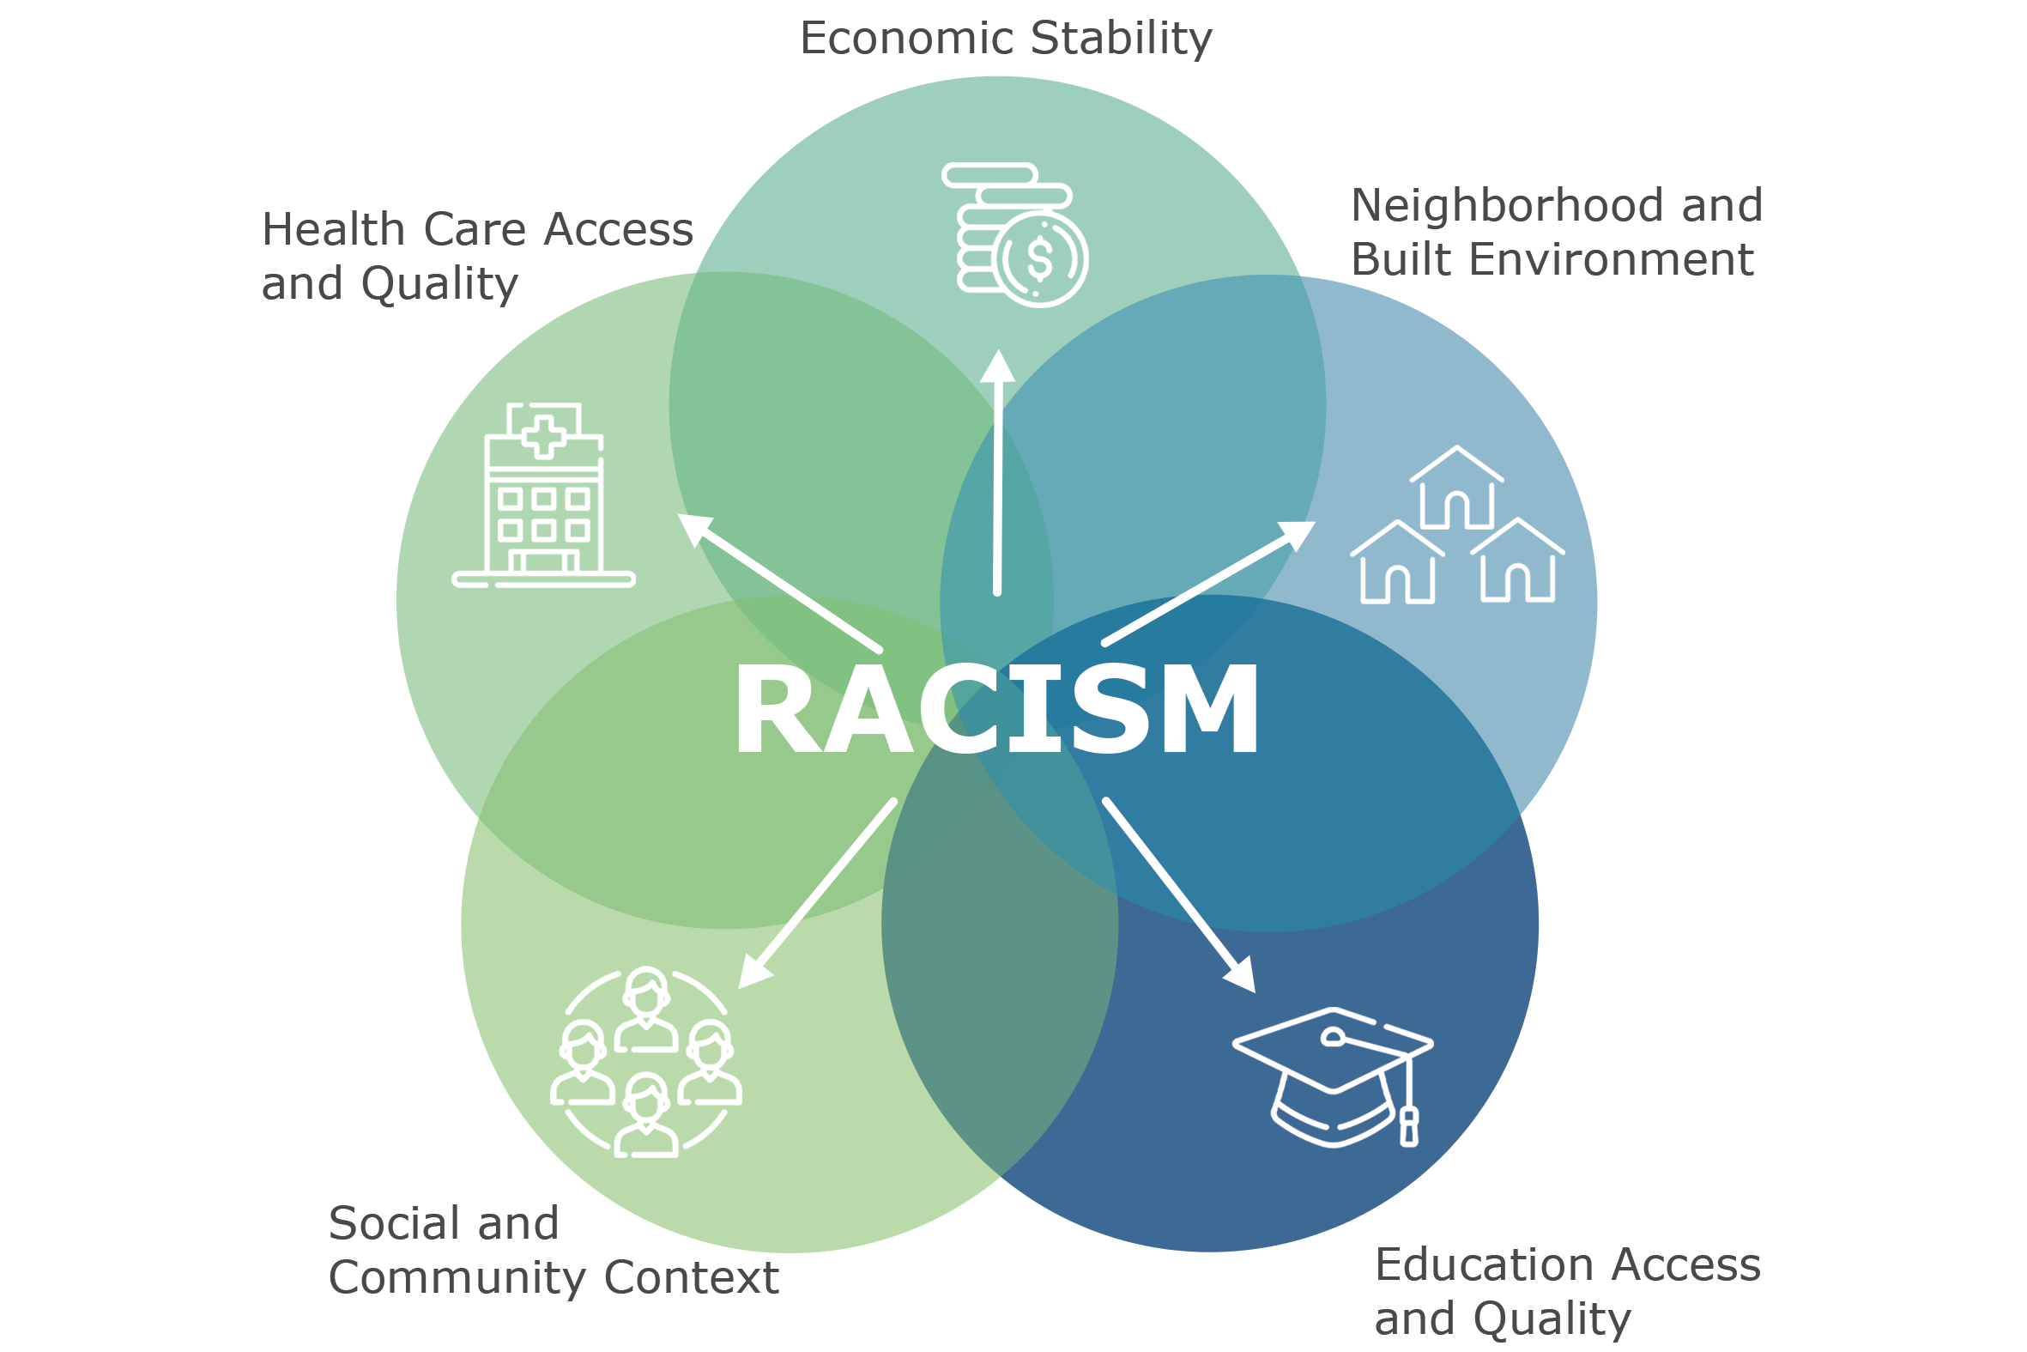
Racism undermines all of the
social determinants of health
Notes:
While the immediate causes of disparities in hypertension, infant mortality, and mental health may be quite different – they are largely rooted in the same underlying issues – the SDOH.
As we all know, so much of a population’s health is driven by factors like financial stability, neighborhood resources, and education.
I’ve seen some SDOH models that include racism as part of the social/community context, but I think it’s important and more accurate to acknowledge that racism negatively impacts ALL of the SDOH.
The report highlights how racism undermines every one of these SDOH…
FOR EXAMPLE:
-- racism makes it harder for Black people to get jobs with good pay and good health benefits
-- racism has created and maintains segregated/disinvested neighborhoods, where it’s hard for Black residents to get convenient access to grocery stores or health facilities.
-- racism creates stressors on everyday life that leads to higher rates of physical and mental health conditions

Slide 15
www.commonground Download the report www.CommonGroundHealth.org/ColorofHealth

Slide 16
Driving Forces for People Living in Generational Poverty
Survival

Slide 17
Stressors of poverty invade the body
Stress
Neurons
Neurons
HPA Axis
HPA Axis
CORTISOL

Slide 18
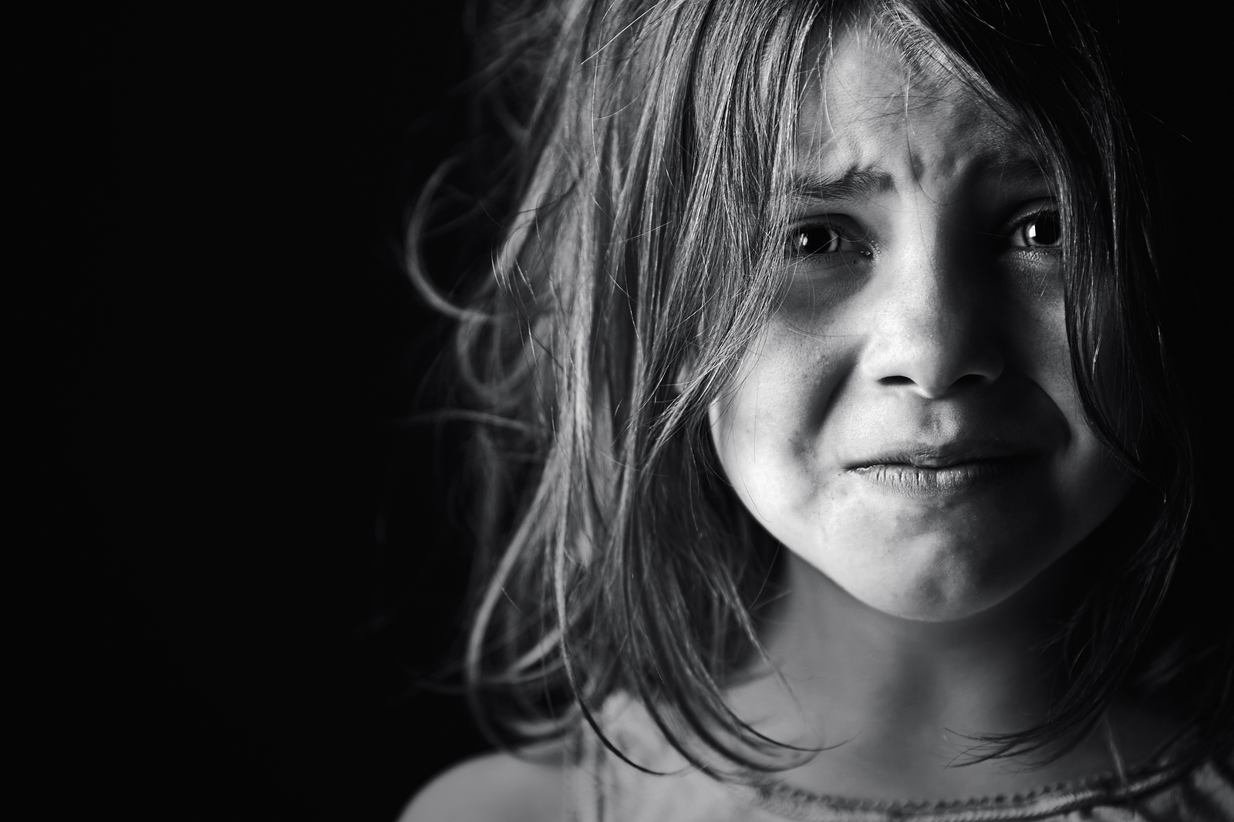
CORTISOL
The Stress Hormone
Depression
Trauma
Fear
Abuse
Fight Flight Freeze
Stress Regulation impaired
Cognitive skills diminished

Slide 19
Education
Poverty Survival Comes First
Middle Class School Comes First
Wealth Connection Base First

Slide 20
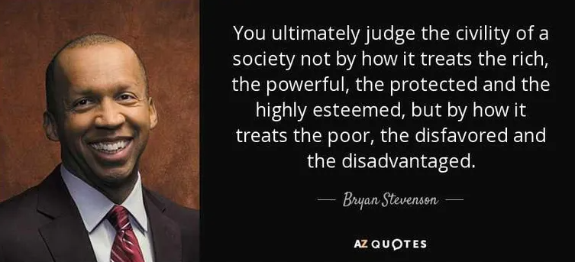
QUESTIONS?

